Slide 1
Chapter 2: Stellaris® family of microcontrollers
Stellaris® CortexTM-M3 - Microcontroller Family
Texas Instruments
Texas Instruments - University Program
Heilbronn University, Campus Künzelsau
Prof. Dr.-Ing. Ralf Gessler Rev. 1.0

Slide 2
Content
Chapter 2: Stellaris® family of microcontrollers 2.1 Overview MCU 2.2 CortexTM -M3: Processor and Peripherals 2.3 CortexTM -M3: Programmer model (ISA) 2.4 Peripherals
Topics: MCU, ARM® processor core, on-chip memory, system peripherals, serial interface peripherals, motion control peripherals, analog peripherals

Slide 3
Learning Objectives
The chapter describes the basics (theory) of the Stellaris® Family
Architecture (common)
Stellaris® Module “System”.
Additional Links for the other Stellaris® Modules are given.
Structure and questions:
What are the features of the Stellaris® family?
What are the Stellaris® product lines?
What does a Stellaris® Module “System” looks like?

Slide 4
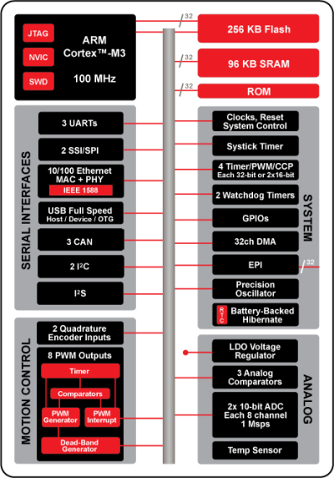
Overview MCU
Microcontroller Unit (MCU)
ARM® CortexTM -M3 Processor Core
Up to 100 MHz
Joint Test Action Group (JTAG) Interface
Nested Vectored Interrupt Ctrl. (NVIC)
Serial Wire Debug (SWD)
On-chip Memory
256 KB Flash, 96 KB SRAM
ROM loaded with Stellaris® DriverLib,
Bootloader, AES tables, and CRC
System Peripherals
32-channel DMA Controller
Internal Precision 16MHz Oscillator
Two watchdog timers with separate clock domains
ARM Cortex SysTick Timer
4x 32-bit timers (up to 8 16-bit) with RTC capability
80 MHz

Slide 5
Overview (cont.)
System Peripherals (cont.)
Lower-power battery-backed hibernation module
External Peripheral Interface (EPI)
32-bit dedicated parallel bus for external peripherals
Supports SDRAM, SRAM/Flash, M2M
Serial Interface Peripherals
3 Univ. Asyn. Rec./Trans. (UARTs) with Infrared Data Association (IrDA) and ISO 7816 support
2 Synchronous Serial Interfaces (SSI)
10/100 Ethernet MAC and PHY
Universal Serial Bus (USB) (full speed) OTG / Host / Device
3 Controller Area Network (CAN) 2.0 A/B Controllers
2 Inter-Integrated Circuits (I²Cs)
Integrated Interchip Sound (I²S)
80 MHz

Slide 6
Overview (cont.)
Motion Control Peripherals
8 advanced PWM outputs for motion and energy applications
2 Quadrature Encoder Inputs (QEI)
Analog Peripherals
2 x 8-ch 10-bit ADC (for a total of 16 channels)
3 analog comparators
On-chip voltage regulator (1.2V internal operation)
Low-Drop-Out (LDO)
Flexible pin-muxing capability
80 MHz

Slide 7
Device Choice
Product lines: LM3S1nnn to LM3S9nnn
ARM® CortexTM-M3 Processor Core
Same CortexTM -M3 core
CPU frequency depends on product lines
Memory
Size of internal Flash and SRAM depends on product lines
System peripherals
Quantity depends on product lines
same
functionality

Slide 8
Device Choice (cont.)
Serial interface peripherals
Features depends on product lines
Motion control peripherals
Features depends on product lines
Analog peripherals
Features depends on product lines
Note: For each target application a product line
functionality
depends on
product line

Slide 9
Section Links: Peripherals
ARM® CortexTM -M3 Processor Core
More Details see: Chapter 2.3 “Cortex® -M3: Programmer model (ISA)”
On-Chip Memory
More Details see: Chapter 2.2 “Cortex® -M3: Processor and Peripherals”
Serial Interfaces Peripherals
More Details see: Module 2.4 “Peripherals”: UART, SSI, I²C - LM3S1968 Module 5.3 “Connectivity”: Ethernet, USB - LM3S9B92
Motion Control Peripherals
More Details see: Chapter 2.4 “Peripherals” - LM3S1968
Analog Peripherals
More Details see: Chapter 2.4 “Peripherals” - LM3S1968

Slide 10

System Peripherals
80 MHz

Slide 11
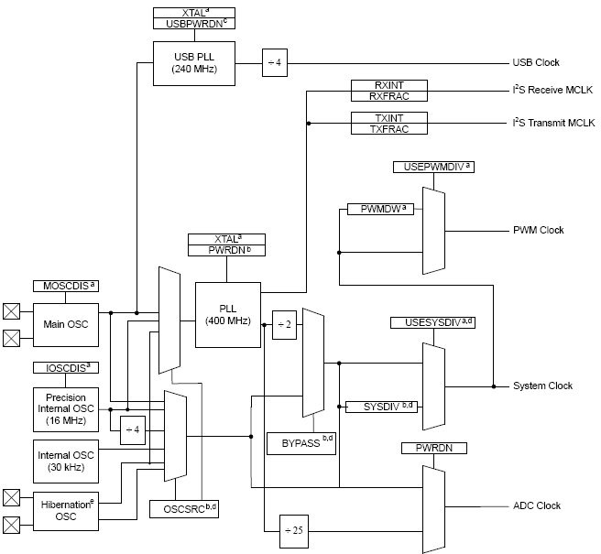
Clock architecture
Main OSCillator (OSC)
3.579545 MHz through 16.384 MHz if PLL used
Precision Internal Oscillator (PIOSC)
On-chip precision 16 MHz clock (clk) (±1% at room temperature)
Does not require any external components
Internal OSC
Hibernation OSC

Slide 12
Example: System Control
System Control determines the overall operation of the device. It controls the clocking of the device, the set of peripherals that are enabled, configuration of the device, its resets and provides information about the device.
System Control is part of Stellaris® Peripheral Driver Library.
Link: see Chapter 3.4 “StellarisWare®”
Example:
Link: see Lab “lab21a.zip”
…
//
// Set the clocking to run directly from the crystal.
//
SysCtlClockSet(SYSCTL_SYSDIV_1 | SYSCTL_USE_OSC | SYSCTL_OSC_MAIN |
SYSCTL_XTAL_8MHZ);
…

Slide 13
Reset
Flexible Reset Sources
Power-on Reset (POR)
Reset pin assertion
Brown-Out Reset (BOR) detector alerts to system power drops
The system provides a brown-out detection circuit that triggers if the power supply (VDD) drops below a Voltage Brown-out THreshold (VBTH). If a brown-out condition is detected, the system may generate a controller interrupt or a system reset.
This is initially disabled and may be enabled by software.
Software reset
Watchdog timer reset

Slide 14
System Control
For power-savings purposes, the RCGCn , SCGCn , and DCGCn registers control the clock gating logic for each peripheral or block in the system while the controller is in Run, Sleep, and Deep-Sleep mode, respectively.
There are four levels of operation for the device defined as:
Run Mode: the controller actively executes code
Sleep Mode: the clock frequency of the active peripherals is unchanged, but the processor and the memory subsystem are not clocked and therefore no longer execute code. Sleep mode is entered by the Cortex-M3 core executing a WFI (Wait for Interrupt) instruction. Any properly configured interrupt event in the system will bring the processor back into Run mode.

Slide 15
System Control (cont.)
There are four levels of operation for the device defined as (cont.):
Deep-Sleep Mode: the clock frequency of the active peripherals may change (depending on the Run mode clock configuration) in addition to the processor clock being stopped. An interrupt returns the device to Run mode from one of the sleep modes.
Hibernate Mode: the power supplies are turned off to the main part of the device and only the Hibernation module's circuitry is active. An external wake event or Real Time Clock (RTC) event is required to bring the device back to Run mode.

Slide 16
System Timer
CortexTM -M3 includes an integrated system timer, SysTick. SysTick provides a simple, 24-bit clear-on-write, decrementing, wrap-on-zero counter with a flexible control mechanism.
Link: see Chapter 2.2 “CortexTM -M3: Processor and Peripherals”

Slide 17
Timers
Up to 4 timer modules
Each configurable as single 32-bit timer, or two 16-bit timers
32-bit Timer Modes
32-bit programmable one-shot timer with selectable clock
32-bit programmable periodic timer with selectable clock
RTC using a 32.768 kHz input clock
Software controlled debug event stalling (except for the RTC function)
16-bit Timer Modes
16-bit general-purpose timer with 8-bit pre-scaler and input clock selection
General-purpose free running timer modes: one-shot or periodic
Selectable debug event stalling
16-bit Capture Modes (CCP)
Input edge count capture
Input edge time capture
PWM mode
Simple PWM mode with programmable output negation

Slide 18
Timers: PWM
PWM signals are driven through CCPx output

Slide 19
Watchdog Timers
Allows software to regain control when there is a system failure caused by software error or an external device
Generates an interrupt or system reset on time-out
Configuration can be locked (key) to prevent inadvertent changes
User-enabled stalling for software debugging
Some Stellaris® MCUs feature two Watchdog Timer Modules, where :
One module is clocked by the system clock (Watchdog Timer 0)
One module is clocked by the PIOSC (Watchdog Timer 1).

Slide 20
Example: Watchdog Timer
Watchdog Timer is part of Stellaris® Peripheral Driver Library.
The Watchdog Timer Application Programming Interface (API) provides a set of functions for using the Stellaris® watchdog timer modules. Functions are provided to deal with the watchdog timer interrupts, and to handle status and configuration of the watchdog timer.
Link Chapter 3.4 “StellarisWare®”
The following example shows how to set up the watchdog timer API. If the watchdog is not periodically fed, it will reset the system. Each time the watchdog is fed, the LED is inverted so that it is easy to see that it is being fed, which occurs once every second.
Link see Lab “lab21a.zip”
Note: example, not a complete application!

Slide 21
Example: Watchdog Timer (cont.)
…
//
// Enable the watchdog interrupt.
//
IntEnable(INT_WATCHDOG);
//
// Set the period of the watchdog timer.
//
WatchdogReloadSet(WATCHDOG0_BASE, SysCtlClockGet());
//
// Enable reset generation from the watchdog timer.
//
WatchdogResetEnable(WATCHDOG0_BASE);
//
// Enable the watchdog timer.
//
WatchdogEnable(WATCHDOG0_BASE);
//
// Loop forever while the LED winks as watchdog interrupts are handled.
//
while(1)
{
}
…

Slide 22
GPIOs
General Purpose Input/Outputs (GPIOs)
Programmable pad configuration through GPIO module
Any GPIO can be full featured external interrupt
Bit addressable pins, atomic operation
Fast output toggling: Toggle rate up to ½ the CPU clock
5-V-tolerant inputs

Slide 23
GPIOs (cont.)
Up to 61 GPIO available on a single device
Programmable Drive Strength
2 mA, 4 mA, 8 mA or 8 mA with slew rate control
Programmable weak pull-up, pull-down
Open drain enables
Digital input enables
Link: see Chapter 4.1 “General Purpose Input/Output (GPIO)”

Slide 24
Direct Memory Access
Direct Memory Access (DMA)
32-channel configurable μDMA controller
Dedicated channels for supported peripherals
One channel each for receive and transmit path for bidirectional peripherals
Multiple data sizes, Two levels of priority, Maskable device requests
Interrupt on transfer completion with a separate interrupt per channel
Support for multiple transfer modes:
Basic, for simple transfer scenarios
Ping-pong, for continuous data flow to/from peripherals
Scatter-gather, from a programmable list of arbitrary transfers initiated from a single request
DMA requests
UART, Timer, USB, Ethernet, ADC, SSI, External Peripherals I/F

Slide 25
DMA (cont.)

Slide 26
External Peripheral Interface
External Peripheral Interface (EPI)
Multiple device types supported
SDRAM: Supports x16 (Single Data Rate) at up to 50MHz
Supports low-cost SDRAMS up to 64 MB
Includes automatic refresh and access to all banks/rows
Includes a sleep/standby mode to keep contents alive with minimal power draw
Host-Bus Interface: Traditional x8 and x16 MCU bus interface capabilities
Support of both muxed and de-muxed address and data
Access to SRAM, NOR Flash, and other devices, with up to 1MB of addressing or up to 256 MB for muxed mode
Speed controlled, with read and write data wait-state counters
Machine-to-Machine (M2M): Wide parallel interfaces for fast communications
For instance, CPLDs and FPGAs
Data widths up to 32-bits, data rates up to 150 Mbytes/second
Optional “address” sizes from 4-bits to 16-bits
Optional clk output, read/write strobes, framing (with counter-based size), and clk-enable input
Other features
General parallel GPIO, FIFOed with speed control
Blocking and non-blocking reads
FIFOed writes separate the processor from timing details
Direct memory access (DMA)

Slide 27
EPI block diagram
Cortex M3
External Peripheral Interface (EPI)
Stellaris
DMA

Slide 28
Hibernation module
Two mechanisms for power control
System power control using discrete external regulator
On-chip power control using internal switches under register control
Dedicated pin for waking using an external signal
Low-battery detection, signaling, and interrupt generation
32-bit real-time counter (RTC)
Two 32-bit RTC match registers for timed wake-up and interrupt generation
RTC pre-divider trim for making fine adjustments to the clock rate
Clock source from a 32.768 kHz external oscillator or a 4.194304 MHz crystal - 32.768 kHz external oscillator can be used for main clock
64 32-bit words of non-volatile memory to save state during hibernation
Programmable interrupts for RTC match, external wake, and low battery events

Slide 29
Power architecture
3 power domains
Core Supply: VDDC
Supply Voltage: VDD
Analog circuitry: VDDA

Slide 30
Power consumption
Battery-backed Hibernation Module (Standby current as low as 10μA)
32-bit real-time counter (RTC)
Programmable 32.768 kHz external oscillator or a 4.194304 MHz crystal
RTC software trim for making fine adjustments to the clock rate
Power-switching logic to discrete external regulator (switch to battery)
Low-battery detection, signaling, and interrupt generation
Wake on RTC match and / or external pin
On-chip Low Drop-Out (LDO) voltage regulator
Low-power options on controller: Sleep and Deep-sleep modes
Low-power options for peripherals: software controls shutdown of individual peripherals
3.3V supply brown-out detection and reporting via interrupt or reset

Slide 31
Power consumption (cont.)
Note: Battery supply current (Ibat)
 | SRAM saved | Lowest Ibat | Lowest type wake-up
Running mode | Yes | 1.12 mA/MHz | N/A
Sleep mode | Yes | 8 mA | 0.427μs
Deep-Sleep mode | Yes | 550 μA | 0.427μs
Hibernate RTC ON | 256 bytes saved | 18 μA | 62 μs
Hibernate RTC OFF | 256 bytes saved | 8 μA | 10 ms

Slide 32
Example: Sleep Mode
SysCtlSleep and SysTick are parts of System Control (Stellaris® Peripheral Driver Library).
CPUUsage is part of LM3S1968 Firmware Development Package.
Link: see Chapter 3.4 “StellarisWare®”
Link: see Lab “lab21b.zip”
Note: example, not a complete application!
The following example shows how to use the CPU usage module to measure the CPU usage where the foreground simply burns some cycles.

Slide 33
Example: Sleep Mode
…
//
// The CPU usage for the most recent time period.
//
unsigned long g_ulCPUUsage;
//
// Handles the SysTick interrupt.
//
void
SysTickIntHandler(void)
{
//
// Compute the CPU usage for the last time period.
//
g_ulCPUUsage = CPUUsageTick();
}
//
// The main application.
//
int
main(void)
{
//
// Initialize the CPU usage module, using timer 0.
//
CPUUsageInit(8000000, 100, 0);
…
…
//
// Initialize SysTick to interrupt at 100 Hz.
//
SysTickPeriodSet(8000000 / 100);
SysTickIntEnable();
SysTickEnable();
//
// Loop forever.
//
while(1)
{
//
// Delay for a little bit so that CPU usage is not zero.
//
SysCtlDelay(100);
//
// Put the processor to sleep.
//
SysCtlSleep();
}
}
…

Slide 34
Questions and Exercises
What are the main modules of the Stellaris® family?
Explain a Watchdog Timer.
Explain Hibernation.
What is DMA?

Slide 35
Summary and Outlook
Summary
From the Stellaris® Family Architecture in common to Stellaris® family product lines
From the Device Choice to Module “System”
Outlook/How to go on?
Chapter 4: “Peripheral Programming in C” shows the practical use in C

Slide 36
References
[1] Henri, G.; Texas Instruments: MCU Training Module - System and Peripherals. EMEA, Oct. 7, 2010.
[2] Henri, G.; Texas Instruments: MCU Training Module - Solution overview. EMEA, Jul. 21, 2010.
[3] Texas Instruments: Data Sheet - Stellaris® LM3S1968. Chapter 1: “Architectural Overview”, Chapter 5.1.5: “System Control”, spms037f.pdf, 2011.
[4] Texas Instruments: User’s Guide - Stellaris Peripheral Driver Library. SW-DRL-UG-6075.pdf, 2010.
[5] Texas Instruments: User’s Guide - EK-LM3S1968 Firmware Development Package. SW-EK-LM3S1968-UG-6075.pdf, 2010.

